Slide 1
Anesthesia for Neurosurgery

Slide 2
Part I Anesthesia for Neurosurgery
By Siryet Tesfaye
For fourth year students

Slide 3
Out line
Neuro anatomy and Physiology
Cerebral Blood Flow and Its Control
The Intracranial Compartment and Intracranial Pressure
Intra operative Brain Protection
Anaesthesia for elective intracranial surgery
Special type of problems (surgeries
Anaesthesia for emergency intracaranial neurosurgical procedures
Surgery of spine and spinal cord

Slide 4
Assignments
1. Effects of different surgical Position in Neuro Anesthesia.
2. Pathophysiology of cerebral ischemia and its management
3. Anesthetic management in pregnant neuro surgical patients and fluid management in neurosurgical cases.
4.Monitoring for different type of neurosurgical procedures.
4.1 CBF Monitoring
4.2 CNS monitoring

Slide 5
C0nt
6. Parkinsons disease
Alzimers
Definition,
sign and symptom
Pathophysiology
Anesthetic consideration

Slide 6
Introduction
The anesthetic care of patients who undergo neurosurgery requires a basic understanding of the physiology of the central nervous system (CNS).
The effects of anesthetic agents on cerebral metabolism, blood flow, cerebrospinal fluid (CSF) dynamics, and intracranial volume and pressure are often profound.

Slide 7
Cont…
In some instances, these alterations are deleterious, whereas in others they may actually be beneficial.
This course reviews important physiological concepts in anesthetic practice and then discusses the effects of commonly used anesthetics on cerebral physiology.
Although most of the discussion focuses on the brain, the same concepts also apply, at least qualitatively, to the spinal cord.

Slide 8
For practical purposes, many surgeons divide the intracranial compartment into
supratentorial and infratentorial compartments.
The supratentorial compartment contains the cerebral hemispheres and the diencephalon, whereas the infratentorial compartment includes the brainstem and cerebellum.

Slide 9
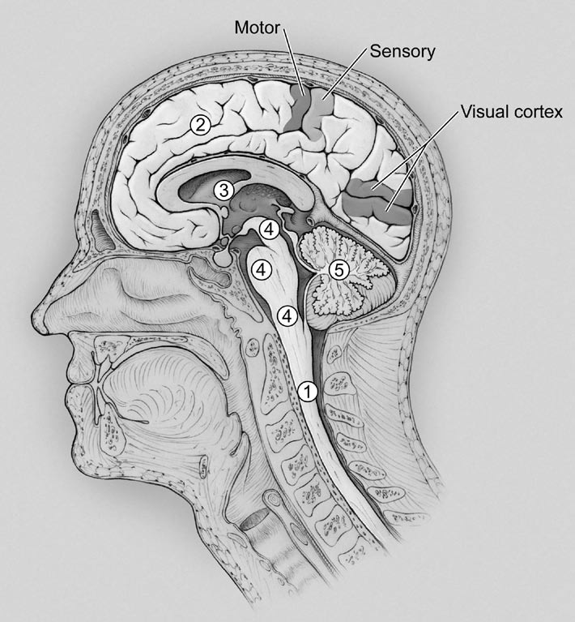
(1) spinal cord; (2) cerebral hemispheres;
(3) diencephalon, (4) brainstem, consisting of the medulla, pons, and midbrain; and (5) cerebellum

Slide 10
Supratentorial Compartment
Cerebrum and Neocortices
The cerebral hemispheres consist of the cerebral cortex, white matter projections, and a few deep structures, including the basal ganglia and hippocampus/
The cortex is highly convoluted with infoldings called sulci and bumps or ridges called gyri.

Slide 11
Each hemisphere is divided into four major lobes: frontal, parietal, temporal, and occipital
The hemispheres are principally defined by the midline interhemispheric fissure, the central sulcus in the posterior frontal lobe, and the large lateral sylvian fissure.

Slide 12
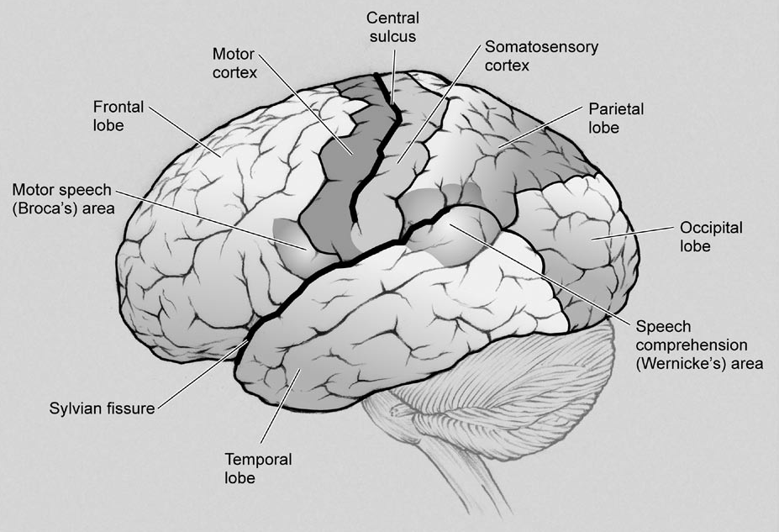

Slide 13
Diencephalon
The diencephalon sits above the midbrain and consists of the thalamus and hypothalamus.
The thalamus is “an information relay station.” All sensory modalities pass through the thalamus, and there are many reciprocal connections

Slide 14
The hypothalamus, located just inferior to the thalamus, controls endocrine, autonomic, and visceral function. The hypothalamus is connected to the pituitary gland by the infundibulum, which continues as the pituitary stalk

Slide 15
Infratentorial Compartment
Brainstem
The brainstem, a highly complex and clinically critical region of the CNS, consists of the medulla, pons, and midbrain Unlike any other region of the brain, it is at the same time the anatomic substrate of consciousness, a regulator of autonomic function

Slide 16
Cerebellum
The cerebellum is found in the posterior cranial fossa
It is attached to the brainstem by the three cerebellar peduncles at the level of the fourth ventricle. This intimate relationship between the cerebellum and brainstem puts the patient’s life in danger in cases of acute cerebellar edema.

Slide 17
it controls axial posture via neocortical projections.
Lesions of the cerebellum typically produce deficits ipsilateral to the lesion because the output of the cerebellum is crossed, and it affects primarily the descending motor pathways, which are also crossed.
Typical symptoms include ataxia and truncal tremor (titubation)

Slide 18
Cerebral Circulation
The brain has the highest metabolic requirements of any organ in the body.
It receives 14% of the resting cardiac output in adults (≈700 mL/min) and accounts for 20% of basal oxygen consumption (≈50 mL/min).

Slide 19
Blood flow within the brain is variable, with flow in gray matter (80 to 110 mL/100 g tissue/min) being on average five times that in white matter (22 mL/100 g/min).

Slide 20
The arterial supply to the brain is from
1) both the right and left internal carotid arteries (ICAs) supplying the anterior two thirds of the cerebral hemispheres and
2) the vertebrobasilar system, which supplies the brainstem and posterior regions of the hemispheres.

Slide 21
Each ICA gives rise to a posterior communicating artery before ending by dividing into the anterior cerebral artery (ACA) and middle cerebral artery (MCA)
The ACA runs medially and then superiorly and supplies the undersurface of the frontal lobe and the medial neostriatum

Slide 22
Anastomoses between the internal carotid system and the vertebrobasilar system form the circle of Willis

Slide 23
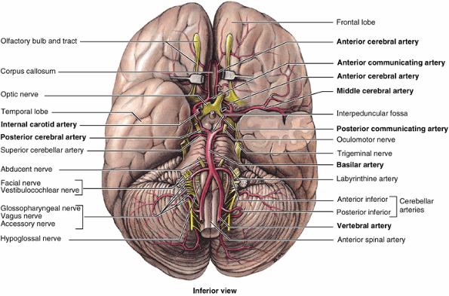

Slide 24
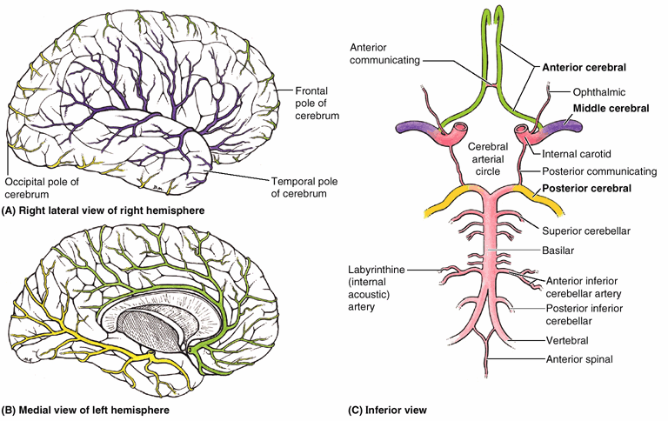

Slide 25
Venous Drainage
Venous drainage consists of a series of external and internal veins that drain into the venous sinuses.
Many clinicians are concerned that IJV central lines will impair venous drainage from the brain and that this impairment may lead to increased intracranial pressure in the intact skull of a susceptible patient.
However, evidence to support this as being clinically relevant is weak.

Slide 26
The CNS is bathed in cerebrospinal fluid (CSF), which is created in the ventricles by the choroid plexus at a rate of about 15 to 20 mL/hr in adults and circulates through the ventricular system to the subarachnoid space.

Slide 27
Spinal Cord
The spinal cord extends from the base of the skull and tapers down to the conus, where it becomes the filum terminale between T12 and L2.

Slide 28
The principal functions of the spinal cord are:-
its central gray matter lies the cellular circuitry underlying the motor function of most of the body.

Slide 29
receives sensory input from the peripheral nerves and transmits this input to higher structures.
The primary ascending tracts are the posterior columns and the lateral spinothalamic tract

Slide 30
The spinal white matter contains a number of descending tracts that are used by higher CNS structures to regulate spinal cord function either by directly stimulating cells or by regulating interneurons that increase or decrease signaling efficiency.

Slide 31
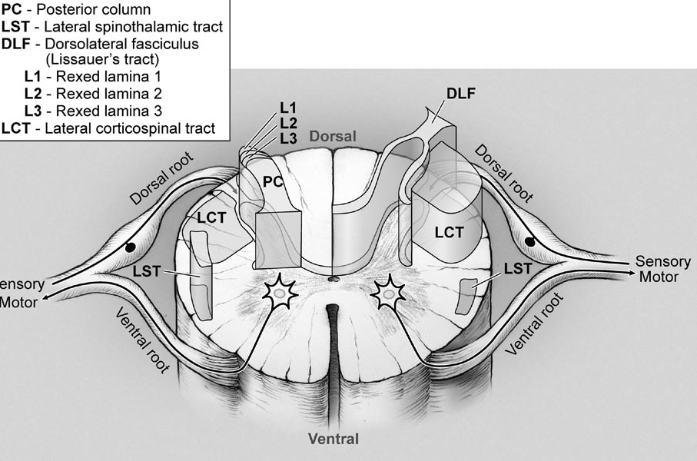

Slide 32
Cerebrospinal Fluid
CSF is found in the cerebral ventricles and cisterns and in the subarachnoid space surrounding the brain and spinal cord. Its major function is to protect the CNS against trauma.
Most of the CSF is formed by the choroid plexuses of the cerebral (mainly lateral)ventricles.
In adults, normal total CSF production is about 21 mL/h (500 mL/d), yet total CSF volume is only about 150 mL.

Slide 33
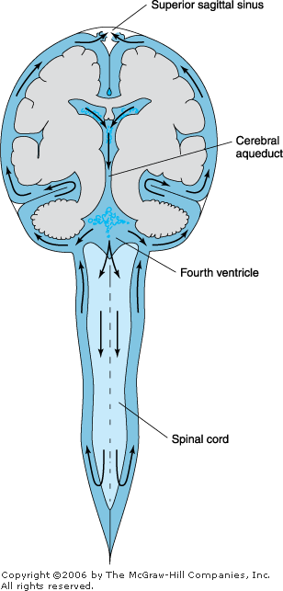

Slide 34
CSF formation
CSF formation involves active secretion of sodium in the choroid plexuses.
The resulting fluid is isotonic with plasma despite lower potassium, bicarbonate, and glucose concentrations.

Slide 35
Absorption of CSF
Absorption of CSF involves the translocation of fluid from the arachnoid granulations into the cerebral venous sinuses. Smaller amounts are absorbed at nerve root sleeves and by meningeal lymphatics.

Slide 36
Blood supply to SC
Blood is supplied to the spinal cord by paired posterior spinal arteries and a single anterior spinal artery.
posterior arteries supply the dorsal horns and white matter columns.
Anterior spinal artery supplies the anterior two thirds of the cord.

Slide 37
Cont…
Six to eight prominent radicular arteries supply the anterior spinal artery network, most numerous in the cervical region and least in the thoracic.
The artery of Adamkiewicz, the main thoracolumbar radicular vessel,supplies the spinal cord from T8 to the conus. This artery arises in the T9-L2 region and mostly from the left side of the aorta.

Slide 38
Cont…
Spinal artery perfusion pressure is an important consideration, especially in the prone position

Slide 39
Blood-Brain Barrier
The endothelial cells in cerebral capillaries contain specialized tight junctions. As a result, cerebral capillary endothelium has high electrical resistance and is relatively impermeable.
Passage of substances across an intact blood-brain barrier is predominantly a function of lipid solubility and the presence of active transport systems.

Slide 40
Cerebral Blood Flow and Its Control
The brain has a high metabolic rate and receives approximately 15% of cardiac output. Under normal circumstances, cerebral blood flow (CBF) is approximately 50 mL/100 g/min.
Gray matter receives 80% and white matter receives 20% of this blood flow
CBF therefore parallels metabolic activity

Slide 41
Autoregulation
Autoregulation is the ability of the cerebral circulation to maintain CBF at a relatively constant level by altering cerebrovascular resistance (CVR) despite wide fluctuations in cerebral perfusion pressure (CPP)

Slide 42
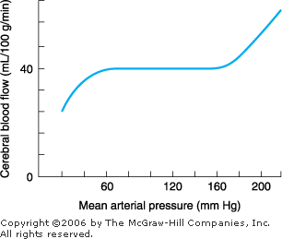

Slide 43
Cont…
Thus, chronic hypertension or sympathetic activation shifts the autoregulatory curve to the right, whereas sympathetic withdrawal shifts it to the left. Intracranial pathology and anesthetic agents, especially inhalational agents, may alter autoregulation.

Slide 44
Myogenic Regulation (Autoregulation) of Cerebral Blood Flow
changes in CPP lead to direct changes in the tone of vascular smooth muscle; this process appears to be passive. NO may participate in the vasodilation associated with hypotension. Autonomic innervation of cerebral blood vessels may also contribute to autoregulation of blood flow

Slide 45
Neurogenic Regulation of Cerebral Blood Flow
The greatest neurogenic influence appears to be exerted on larger cerebral arteries. This innervation includes cholinergic ,adrenergic,and serotonergic.
Works by influences on vascular tone and therefore CBF

Slide 46
Cont…
Activation of cerebral sympathetic innervation also shifts the upper limit of autoregulation to the right and offers some protection against hypertensive breakthrough of the BBB

Slide 47
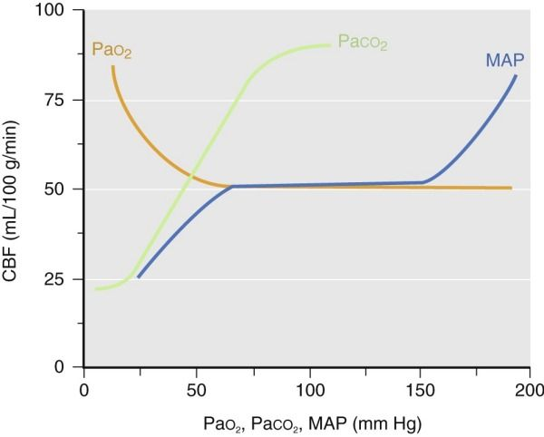

Slide 48
Factors affecting CBF
Arterial Carbon Dioxide Tension
CBF is proportional to arterial carbon dioxide tension (Paco2), subject to a lower limit, below which vasoconstriction results in tissue hypoxia and reflex vasodilation, and an upper limit of maximal vasodilation

Slide 49
Cont…
On average, in the midphysiologic range, each 1-kPa (7.5 mm Hg) change in Paco2 produces a change of about 15 mL/100 g/min in CBF (about 25%), which corresponds to a change of about 0.3 mL/100 g in CBV
In patients with low intracranial compliance, this small decrease in CBV can result in dramatic reductions in ICP.

Slide 50
Cont…
The effect of hypocapnia is mediated by an increase in perivascular pH, which is attenuated over time, approximately 6 hours, as extracellular fluid bicarbonate levels fall to normalize interstitial pH. This decreases the longer-term efficacy of such intervention.

Slide 51
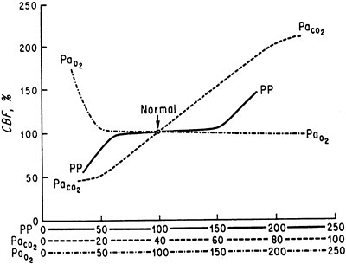

Slide 52
Arterial Oxygen Tension and Content
Changes in Pao₂ from 60 to greater than 300 mm Hg have little influence on CBF. Below a Pao₂ of 60 mm Hg, CBF increases rapidly.
The mechanisms mediating cerebral vasodilation include neurogenic effects initiated by peripheral and neuraxial chemoreceptors, as well as local humoral influences.

Slide 53
Cont…
At least part of the hyperemic response to hypoxia is mediated by NO of neuronal origin. Hypoxia-induced hyperpolarization of vascular smooth muscle by the opening of ATP-dependent K⁺ channels also leads to vasodilation.

Slide 54
Other global factors affecting CBF
Include hematocrit; sympathetic tone, with
Β1-stimulation ,α2- stimulation , Systemic Vasodilators
and Temperature changes

Slide 55
Hematocrit
In healthy subjects, variation of the hematocrit within the normal range (33% to 45%) probably results in only modest alterations in CBF. Beyond this range, changes are more substantial.

Slide 56
Catecholamine Agonists/Antagonists
The effects of these anesthetics on cerebral physiology are dependent on basal blood pressure, the magnitude of the systemic blood pressure changes that occur as a result of administration of the agent of interest, the status of the autoregulation mechanism, and the status of the BBB.

Slide 57
Agonist Cerebral Blood Flow Cerebral Metabolic Rate
Pure
α₁ 0/- 0
α₂ - 0
β + +
β (BBB open) +++ +++
Dopamine ++ 0
Dopamine (high dose) - ?0
Fenoldopam - ?0
Mixed
Norepinephrine 0/- 0/+
Norepinephrine (BBB open) + +
Epinephrine + +
Epinephrine (BBB open) +++ +++

Slide 58
Systemic Vasodilators
The majority of the drugs used to induce hypotension also cause cerebral vasodilation. As a result, CBF either increases or is maintained at prehypotensive levels.
The effects of these anesthetics on ICP are less dramatic when hypotension is induced slowly.

Slide 59
TEMPERATURE
The effects of hypothermia on the brain have been reviewed in detail.
CMR decreases by 6% to 7% per 1⁰ c of temperature reduction.
As is the case with some anesthetic drugs, hypothermia can also cause complete suppression of the EEG (at about 18°C to 20°C).

Slide 60
Effects Of Anesthetic Agents On Cerebral Blood Flow
Intravenous Agents
Propofol, thiopental, and etomidate all cause global reductions in cerebral metabolism and CBF. Although autoregulation, flow-metabolism coupling, and CO₂ responsiveness remain intact even with high doses of propofol and thiopental, care should be exercised to avoid arterial hypotension, which may compromise CPP.

Slide 61
Barbiturates
Barbiturates have four major actions on the CNS:
(1) hypnosis,
(2) depression ofCMR,
(3) reduction of CBF due to increased cerebral vascular resistance, and
(4) anticonvulsant activity.
These properties make barbiturates, particularly thiopental, the most commonly used induction agents in neuroanesthesia.

Slide 62
Cont…
Barbiturates produce dose-dependent decreases in CMR and CBF until the EEG becomes isoelectric. At that point, maximum reductions of nearly 50% are observed;
additional barbiturate does not further reduce metabolic rate.
Barbiturates reduce metabolic rate uniformly throughout the brain.

Slide 63
Cont…
barbiturate-induced cerebral vasoconstriction occurs only in normal areas.
They tend to redistribute blood flow from normal to ischemic areas in the brain (Robin Hood, or reverse steal phenomenon).
The cerebral vasculature in ischemic areas remains maximally dilated and is unaffected by the barbiturate because of ischemic vasomotor paralysis.

Slide 64
Cont…
Barbiturates also appear to facilitate absorption of CSF.
The resultant reduction in CSF volume, combined with decreases in CBF and cerebral blood volume, makes barbiturates highly effective in lowering ICP.
Their anticonvulsant properties are also advantageous in neurosurgical patients who are at increased risk for seizures.

Slide 65
Studies suggest that barbiturate prophylaxis is effective in preventing brain injury during focal but not global ischemia.
CMR is depressed slightly more than CBF, such that metabolic supply exceeds metabolic demand (as long as CPP is maintained).

Slide 66
Propofol
Propofol reduces CBF and CMR similar to barbiturates and etomidate; however, the decrease in CBF may exceed that in metabolic rate.
propofol appears to have significant anticonvulsant activity.
Moreover, its short elimination half-life makes it a useful agent for neuroanesthesia.
Unfortunately, excessive hypotension and cardiac depression in elderly or unstable patients can compromise CPP.

Slide 67
Etomidate
Like the barbiturates, reduces CMR and CBF. In addition to the indirect effect of reduced cerebral metabolism on blood flow, etomidate is also a direct vasoconstrictor even before metabolism is suppressed.
Its advantage over the barbiturates is that it does not produce clinically significant cardiovascular depression. Prolonged use of etomidate may suppress the adrenocortical response to stress.

Slide 68
Cont…
Its effect on CMR is nonuniform, affecting the cortex more than the brain stem.
Its limited effect on the brain stem may be responsible for greater hemodynamic stability in unstable patients when compared with the effect of barbiturates.
Etomidate also decreases production and enhances absorption of CSF.

Slide 69
Induction with etomidate is associated with a relatively high incidence of myoclonic movements, but these movements are not associated with seizure activity on the EEG in normal individuals.
The drug has been used to treat seizures, but reports of seizure activity following etomidate suggest that the drug is best avoided in patients with a history of epilepsy. In fact, small doses of etomidate can activate seizure foci in patients with epilepsy.

Slide 70
Ketamine
Among the intravenous anesthetics, ketamine is unique in its ability to cause increases in both CBF and CMR.
The majority of investigations indicate that autoregulation is maintained during ketamine anesthesia]; the observed effects of ketamine on cerebral hemodynamics indicate that ketamine increases CMR and secondarily increases CBF. CO₂ responsiveness is preserved.

Slide 71
Cont…
Ketamine is a potent N-methyl-d-aspartate (NMDA) receptor antagonist. In models of focal ischemia, substantial neuroprotection has been demonstrated with the administration of ketamine.
The adverse neuropsychiatric side effects of ketamine, however, have restricted its clinical use for neuroprotection.
Ketamine can elicit seizures in patients with an epileptic diathesis.

Slide 72
Narcotics
There are inconsistencies in the information available, but it is likely that narcotics have relatively little effect on CBF and CMR in the normal, unstimulated nervous system. When changes do occur, the general pattern is one of modest reductions in both CBF and CMR.

Slide 73
Lidocaine
Lidocaine produces a dose-related reduction in CMRO₂ in experimental animalsThis may occur because the membrane-stabilizing effect of lidocaine also reduces the energy required for maintenance of membrane integrity

Slide 74
Benzodiazepine
Benzodiazepines have been shown to reduce CMR and CBF; however, this effect is not as pronounced as that with the barbiturates.
As with the barbiturates, the blood flow reduction by benzodiazepines is thought to be secondary to a reduction in CMR. Benzodiazepines may reduce ICP owing to their effect on CBF.

Slide 75
Muscle Relaxants Nondepolarizing Relaxants
The only recognized effect of nondepolarizing relaxants on the cerebral vasculature occurs via the release of histamine .
Histamine can result in a reduction in CPP because of the simultaneous increase in ICP (caused by cerebral vasodilation) and decrease in MAP.

Slide 76
d-Tubocurarine is the most potent histamine releaser among available muscle relaxants. Metocurine, atracurium, and mivacurium also release histamine in lesser quantities.

Slide 77
Vecuronium, in relatively large doses of 0.1 to 0.14 mg/kg, had no significant effect.
Pipecuronium and rocuronium have not been studied but should similarly be without direct effect, and no adverse events have been reported.

Slide 78
Cont…
The indirect actions of relaxants may also have effects on cerebral physiology.
Pancuronium given as a large bolus dose can cause an abrupt increase in arterial pressure. This might elevate ICP in patients with impaired intracranial compliance and defective autoregulation

Slide 79
Muscle relaxation may reduce ICP because coughing and straining are prevented, and this results in lowering of central venous pressure with a concomitant reduction in cerebral venous outflow impedance.

Slide 80
Succinylcholine
Succinylcholine can produce modest increases (∼5 mm Hg) in ICP in lightly anesthetized humans. This effect appears to be the result of cerebral activation (as evidenced by EEG changes and increases in CBF) caused by afferent activity from the muscle spindle apparatus.

Slide 81
Cont…
Deep anesthesia has been observed to prevent succinylcholine-induced increases in ICP in the dog.
In humans, the increase in ICP is also blocked by paralysis with vecuronium and by “defasciculation” with metocurine, 0.03 mg/kg.

Slide 82
Inhalational Agents
Even though volatile anesthetic agents decrease CMRO2
They all cause cerebral vasodilation with a resultant increase in CBF.
Autoregulation is impaired in a dosedependent fashion.
Hypocapnia attenuates these effects

Slide 83
CMR CBF CSF Production CSF Absorption CBV ICP
Halothane -- +++ - - ++ ++
Isoflurane - - - + ± + ++ +
Desflurane - - - + + - + ++
Sevoflurane - - - + ? ? + ++
Nitrous oxide - + ± ± ± +
Barbiturates - - - - - - - ± + - - - - -
Etomidate - - - - - ± + - - - -
Proprofol - - - - - - - ? ? - - - -
Benzodiazepines - - - ± + - -
Ketamine ± ++ ± - ++ ++
Opioids ± ± ± + ± +_
Lidocaine - - - - ? ? - - - -

Slide 84
Cerebral Metabolic Rate
Halothane, desflurane, sevoflurane, and isoflurane produce dose-dependent decreases in CMR. Isoflurane produces the greatest depression (up to 50% reduction),
whereas halothane has the least effect (< 25% reduction).
The effects of desflurane and sevoflurane appear to be similar to isoflurane.

Slide 85
Cerebral Blood Flow & Volume
Volatile anesthetics dilate cerebral vessels and impair autoregulation in a dose dependent Manner .
Halothane has the greatest effect on CBF; at concentrations greater than 1%, it nearly abolishes cerebral autoregulation.

Slide 86
Cerebrospinal Fluid Dynamics
Volatile anesthetics affect both formation and absorption of CSF.
Halothane impedes absorption of CSF but only minimally retards formation.
Isoflurane, on the other hand, facilitates absorption and is therefore the only volatile agent with favorable effects on CSF dynamics.

Slide 87
Intracranial Pressure
The net effect of volatile anesthetics on ICP is the result of immediate changes in cerebral blood volume, delayed alterations on CSF dynamics, and arterial CO2 tension.

Slide 88
Cont…
Based on these factors, isoflurane appears to be the volatile agent of choice in patients with decreased intracranial compliance.
Animal studies suggest that desflurane may increase ICP more than other volatile agents.

Slide 89
Nitrous Oxide
The effects of nitrous oxide are generally mild and easily overcome by other agents or changes in CO₂ tension.
N₂Owith intravenous agents, has minimal effects on CBF, CMR, and ICP.

Slide 90
Cont…
N₂O with volatile anesthetic can further increase CBF.
When given alone, nitrous oxide causes mild cerebral vasodilation and can potentially increase ICP.

Slide 91
Section 2
The Intracranial
Compartment
and Intracranial Pressure

Slide 92
The volume of intracranial contents is
• Brain parenchyma ≈ 1400 mL (80%, of which ≈10% is solid material and ≈70% is tissue water)
• Cerebral blood volume (CBV) ≈ 150 mL (10%)
• CSF ≈ 150 mL (10%)

Slide 93
Intracranial pressure
Intracranial pressure (ICP) is the pressure within the intracranial space relative to atmospheric pressure.
At present, it can be measured only by direct invasive techniques.
“Normal” ICP is generally less than 10 to 15 mm Hg.

Slide 94
Intracranial compliance
Intracranial compliance is determined by measuring the change in ICP in response to a change in intracranial volume.
Normally, increases in volume are initially well compensated.
A point is eventually reached, however, at which further increases produce precipitous rises in ICP.

Slide 96
Major compensatory mechanisms include
1)an initial displacement of CSF from the cranial to the spinal compartment,
2) anincrease in CSF absorption,
3) a decrease in CSF production, and
4) a decrease in total cerebral blood volume (primarily venous).

Slide 97
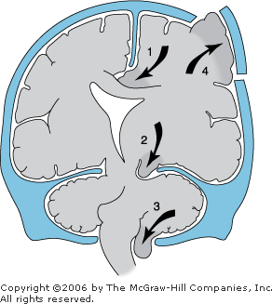
Herniation mayoccur (1) the cingulate gyrus, (2) theuncinate gyrus, (3) the cerebellar tonsils, or (4) any area beneath a defect in the skull

Slide 98
Substantial increase in ICP may lead to a reduction in CBF
CPP = MAP −ICP, which remains one of the cornerstones of current neurointensive care management

Slide 99
Pathophysiologic Mechanisms and Causes of Raised Intracranial Pressure

Slide 100
1. Brain edema
Cytotoxic
Vasogenic
Interstitial

Slide 101
2. Increases in cerebral blood volume
Reduced venous outflow
head-down position, obstructed ventilation, high PEEP, tight neck collar
Increased CBF
Loss of autoregulation

Slide 102
3.Increases in intracranial CSF volume
Decreased CSF absorption at the arachnoid villi—known as communicating hydrocephalus (subarachnoid hemorrhage, infection)
• Obstruction to CSF circulation—obstructive hydrocephalus (neoplasm, traumatic and spontaneous hemorrhage, infection)
• Increased production of CSF (meningitis, choroid plexus tumors)

Slide 103
4. Intra- and extra-axial mass lesions
Neoplastic (intrinsic and extrinsic tumors)
Hemorrhagic
Traumatic (intracerebral, extradural, and subdural hematomas; contusions; CSF hygromas)
Infectious (abscess, subdural empyema, etc.)
Notes:
vv

Slide 104
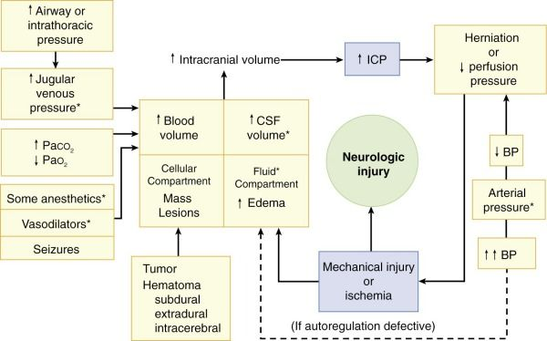

Slide 105
Many current clinical strategies aimed at reducing ICP are based on the described
pathophysiologic mechanisms.

Slide 106
symptoms and signs, including headache, nausea, vomiting, papilledema, focal neurological deficits, and altered consciousness.
When ICP exceeds 30 mm Hg, CBF progressively decreases, and a vicious circle is established: ischemia causes brain edema, which in turn increases ICP, resulting in more ischemia.

Slide 107
Progressive increases in ICP
• Symptoms of brain herniation—
bilateral papillary dilation and absent light reflex, thereby preempting Brainstem death.
Respiratory or circulatory arrest.
Cushing’s triad, which is represented by increasing blood pressure, bradycardia,and widening pulse pressure.

Slide 108
Radiologic Signs of Intracranial Hypertension
midline shift, obliteration of the basal cisterns, loss of sulci, ventricular effacement (or enlarged ventricles in the event of hydrocephalus), and edema.

Slide 109
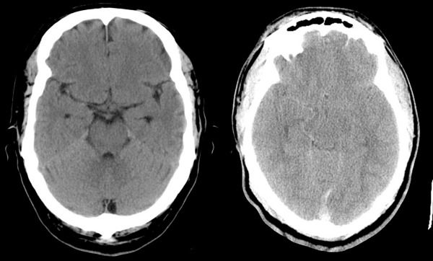

Slide 110
Pathophysiology of Cerebral Ischemia
The brain is very vulnerable to ischemic injury because of its relatively high oxygen consumption and near-total dependence on aerobic glucose metabolism
If normal oxygen tension, blood flow, and glucose supply are not reestablished within 3–8 min under most conditions, ATP stores are depleted and irreversible neuronal injury begins.
`

Slide 111
Pathophysiology of Cerebral Ischemia
Interruption of cerebral perfusion rapidly results in functional impairment.
Reduced perfusion also impairs clearance of potentially toxic metabolites.

Slide 112
Under normal circumstances, CBF is maintained at a relatively constant rate of 50 mL/100 g/min.
With a reduction in cerebral perfusion pressure, CBF declines gradually.
Physiologic indices of ischemia are not apparent until CBF is reduced to about 20 to 25 mL/100 g/min;

Slide 113
If normal oxygen tension, blood flow, and glucose supply are not reestablished within 3–8 min under most conditions, ATP stores are depleted and irreversible neuronal injury begins.

Slide 114
During ischemia, intracellular K+ decreases and intracellular Na+ increases.
More important, intracellular Ca2+ increases because of failure of ATP-dependent pumps to either extrude the ion extracellularly or into intracellular cisterns, increased intracellular Na+ concentration, and release of the excitatory neurotransmitter glutamate.

Slide 115
Sustained increases in intracellular Ca₂⁺ activate lipases and proteases, which initiate and propagate structural damage to neurons.
Increases in free fatty acid concentration and cyclooxygenase and lipooxygenase activities result in the formation of prostaglandins and leukotrienes, some of which are potent mediators of cellular injury.

Slide 116
Cont…
Accumulation of toxic metabolites such as lactic acid also impairs cellular function and interferes with repair mechanisms.

Slide 117
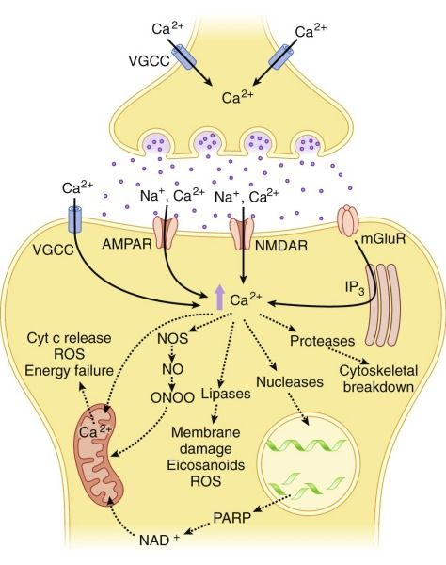

Slide 118
Intraoperative Brain Protection
Selection of Anesthetics
Generally, intravenous anesthetic, analgesic, and sedative drugs are associated with parallel reductions in CBF and cerebral metabolic rate (CMR) and do not have adverse effects on ICP. Except Ketamine

Slide 119
Barbiturates
A dose-dependent reduction in CBF and CMR occurs with barbiturates
Barbiturates are also effective in reducing elevated ICP and controlling epileptiform activity.
Note should be made of the fact that long-term neuro protection with barbiturates has not yet been demonstrated.

Slide 120
Cont…
In the setting of global ischemia, barbiturates given in electroencephalographic (EEG) burst suppression doses do not reduce ischemia injury.
By contrast, barbiturates can reduce the extent of focal cerebral injury.

Slide 121
Propofol
In healthy volunteers, surgical levels of propofol reduced regional CBF by 53% to 79% in comparison with the awake state.
The whole-brain metabolic rate decreased by 48% to 58%, with limited regional heterogeneity observed.

Slide 122
Cont…
Experimental studies have shown that propofol can substantially reduce the ischemic injury produced by stroke; its efficacy is similar to that of barbiturates and volatile anesthetics.
Like volatile agents, propofol neuroprotection is not sustained with moderate to severe insults.
With mild insults, sustained neuroprotection has been demonstrated.

Slide 123
Etomidate
Etomidate can reduce CMRO2 by up to 50% by producing EEG burst suppression.
Unlike barbiturates, etomidate is cleared rapidly and does not cause myocardial depression or hypotension.
These properties make etomidate an ideal agent for purposes of neuroprotection.

Slide 124
Cont…
In human investigations of focal ischemia, administration of etomidate leads to a greater degree of tissue acidosis and hypoxia than noted with desflurane anesthesia.
The detrimental effects of etomidate have been confirmed in experimental studies, which have shown that brain injury actually increases after the administration of etomidate.

Slide 125
Cont…
This injury-enhancing effect of etomidate has been IntraOperative Brain Protection attributed to its ability to reduce nitric oxide levels in ischemic brain tissue.
Because nitric oxide is thought to be important in the maintenance of blood flow during ischemia, it is conceivable that etomidate might increase the severity of ischemia.

Slide 126
Ketamine
Ketamine is a potent N-methyl-d-aspartate (NMDA) receptor antagonist.
In models of focal ischemia, substantial neuroprotection has been demonstrated with the administration of ketamine.
The adverse neuropsychiatric side effects of ketamine, however, have restricted its clinical use for neuroprotection.

Slide 127
Volatile Anesthetics
A large number of animal investigations have shown that the volatile agents halothane, isoflurane, sevoflurane, and desflurane can reduce cerebral injury in the setting of focal ischemia.
This protective efficacy of volatile agents is as large as that of barbiturates.

Slide 128
Summary
Collectively, the available data indicate that barbiturates can protect the brain and that doses required to achieve this protection may well be less than those that produce EEG burst suppression.
Similarly, protection may also be achieved with clinically relevant concentrations of volatile anesthetics (≈1 minimal alveolar concentration [MAC]) and with propofol.

Slide 129
Body Temperature
Experimental studies have shown that a reduction in temperature of only a few degrees (≈33° C to 34° C) can dramatically reduce the brain’s vulnerability to ischemic injury.

Slide 130
increases in brain temperature during and after ischemia aggravate injury.
An increase of as little as 1° C can dramatically increase injury.
It therefore seems prudent to avoid hyperthermia in patients who have suffered an ischemic insult or those who are risk for cerebral ischemia.

Slide 131
Cerebral Perfusion Pressure
CBF is normally autoregulated over a cerebral perfusion pressure (CPP) range of 60 to 150 mm Hg.
The ideal CPP in such patients has not been adequately studied.
In head-injured patients, however, a higher than normal CPP is required to maintain normal CBF.

Slide 132
Although optimal CPP should be tailored to the individual, a CPP of 60 to 70 mm Hg is adequate in head-injured patients.
A CPP of 70 mm Hg is therefore a reasonable goal in patients who have undergone an ischemic insult, provided that the results of Chan and colleagues can be applied to such patients.

Slide 133
Management of Paco₂
In particular, hyperventilation is now widely avoided in the management of SAH because of the low-CBF state that is known to occur. In addition, brain tissue beneath retractors can have a similarly reduced CBF.

Slide 134
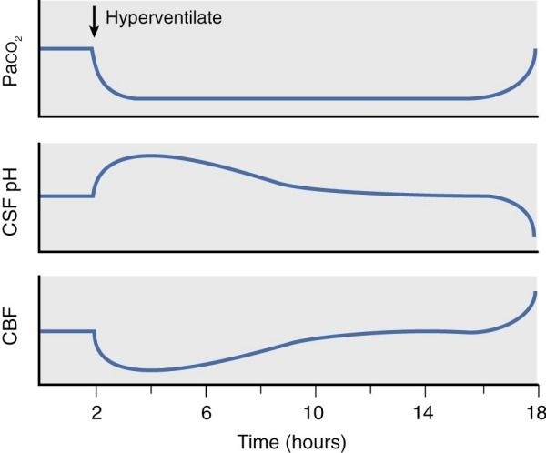

Slide 135
Management of Arterial Blood Pressure
Hypotension can increase cerebral infarct volumes significantly and should be avoided in patients who have suffered a stroke.
Similarly, hypotension has been demonstrated to be one of the most important contributors to a poor outcome in patients who have sustained head injury.
Maintenance of adequate MAP and CPP is therefore critical.

Slide 136
In hypertensive patients, the lower limit of autoregulation is shifted to the right and higher CPP may be required.
Maintenance of CPP that is close to the patient’s normal baseline pressure is prudent.

Slide 137
Blood Glucose
In a normal brain that is adequately perfused, glucose is metabolized aerobically.
When the brain is rendered ischemic, oxygen is no longer available and aerobic metabolism of glucose is inhibited.

Slide 138
Cont…
Glucose is then metabolized anaerobically through glycolysis.
The end products of this pathway are lactic acid and ATP.
The lactic acid produced contributes to the acidosis that occurs in many ischemic tissues.

Slide 139
Because the brain does not have glucose stores, the extent of lactic acidosis is limited.
However, during hyperglycemia, the supply of glucose to the brain is increased.
In this situation the amount of lactic acid produced is considerable and cerebral pH decreases.
This acidosis contributes significantly to neuronal necrosis.

Slide 140
Cont…
Preexisting hyperglycemia has been shown to be associated with increased neurologic injury.
Based on the available data, treatment of a blood glucose level above 150 mg/dL is reasonable.
Consequently, it has been suggested that hyperglycemia be treated in patients at risk for cerebral ischemia and in those who have suffered an ischemic insult.

Slide 141
Cont…
Steroids
The efficacy of steroids in reducing the edema and increasing blood-brain barrier permeability associated with tumors is well confirmed.
Administration beginning 48 hours before an elective surgical procedure has the potential, to reduce edema formation and improve the clinical condition by the time of craniotomy.

Slide 142
Diuretics
To reduce the volume of the brain's intracellular and extracellular fluid compartment.
Osmotic and loop diuretics have been employed.
There is the concern that mannitol is effective only when some degree of blood-brain barrier integrity is preserved in a significant portion of the brain.

Slide 143
Cont…
The doses of mannitol employed vary from 0.25 g/kg to 100 g “for all comers”; 1.0 g/kg seems to be the most common dose. Mannitol should be administered by infusion.
Sudden exposure can produce brain engorgement and increased ICP that does not occur with slower infusions.

Slide 144
Narcotics
There are inconsistencies in the information available, but it is likely that narcotics have relatively little effect on CBF and CMR in the normal, unstimulated nervous system. When changes do occur, the general pattern is one of modest reductions in both CBF and CMR.

Slide 145
Lidocaine
Lidocaine produces a dose-related reduction in CMRO₂ in experimental animals

Slide 146
Benzodiazepines have been shown to reduce CMR and CBF; however, this effect is not as pronounced as that with the barbiturates. As with the barbiturates, the blood flow reduction by benzodiazepines is thought to be secondary to a reduction in CMR. Benzodiazepines may reduce ICP owing to their effect on CBF.

Slide 147
Volatile anesthetics do produce neuroprotection for short periods.
However, this protection is not sustained beyond 2 weeks with moderate and severe insults, which suggests that volatile anesthetics delay but do not prevent neuronal death.

Slide 148
Cont…
in models of very mild focal ischemia, sustained neuroprotection with sevoflurane can be achieved.
These data suggest that volatile agents can produce long-term neuroprotection provided that the severity of injury is very mild.

Slide 149
Anesthesia for elective intracranial surgery

Slide 150
Preoperative Assessment
Why Is the Patient Having This Procedure Now?
Obtaining Information from the Patient and Other Sources
History
Examination
Investigations
Additional Information
Delivering Information to the Patient

Slide 151
Preoperative Optimization of Neurosurgical Patients
Premedication before Neurosurgical Procedures
Planning for Postoperative Management

Slide 152
Why is the Patient Having This Procedure Now?
The timing and urgency of any neurosurgical procedure are crucial.
Certain procedures result in a worse neurologic outcome if undertaken either too early or too late.

Slide 153
Cont…
For example, pretreatment of patients who have significant peritumor edema with steroids may significantly improve preoperative neurologic status
whereas delaying surgery because of rapidly expanding extradural hematomas will have an adverse effect on outcome.

Slide 154
Certain procedures such as craniotomy are generic terms and do not describe the extent of surgery or the actual procedure. and the approach (frontal, temporal, occipital,supine, lateral, prone)
should be ascertained because they directly affect positioning, monitoring, size and location of intravenous access, and provision of cross-matched blood.

Slide 155
History
A routine general anesthetic assessment should be undertaken.
Specific features should be embellished in neuroanesthetic patients.
The size and location of lesions should be identified and their progression appreciated.
In most patients computed tomography (CT) or magnetic resonance imaging (MRI) will be performed to assist in this matter.

Slide 156
Surgery in critical brain regions is well known to be associated with typical postoperative sequelae, such as swallowing difficulties and other cranial nerve palsies in posterior fossa and brainstem surgery and seizures after temporal lobe surgery.
Any treatment up to this point,such as steroids, mannitol, anticonvulsants, chemotherapy, radiotherapy, neurovascular ablation, biopsy, or formal surgery, should be noted.

Slide 157
Many neurosurgical patients have had multiple similar previous operations and anesthetics, so old anesthetic charts are a source of very useful information.
Current comorbidity helps assess overall fitness and suitability for anesthesia and provides areas for optimization if appropriate.

Slide 158
Current and previous medications should be reviewed and documented, any allergies documented along with the reaction.
Therapeutic drug levels (e.g., for anticonvulsants) should be ascertained when appropriate.
Smoking history should be quantified in terms of daily amount, overall duration, and any associated reduction in respiratory function or underlying infection.

Slide 159
There is resistance to nondepolarizing neuromuscular blocking drugs in patients taking anticonvulsant drugs for more than a few days.
The dose requirements of neuromuscular blocking drugs are therefore increased in patients taking phenytoin, carbamazepine, and to a lesser extent other anticonvulsant drugs

Slide 160
acute treatment with anticonvulsant produces a weak neuromuscular block and enhances the action of nondepolarizing neuromuscular blocking drugs.

Slide 161
alcohol consumption has implications for disease causality, nutritional status, hepatic enzyme induction, and withdrawal phenomena.
systems review may identify other areas for concern, such as unidentified comorbidity that requires further investigation.

Slide 162
Examination
Examination of a neurosurgical patient aims to verify any neurologic signs, assess the airway, and establish baseline cardiorespiratory status.
This population of patients usually has symptoms and signs of their neuropathology.

Slide 163
Cont…
An accurate baseline neurologic status is valuable to guide the expected level of recovery in the immediate postoperative period and also to anticipate any complications that may occur.

Slide 164
Assessment of the airway is important to allow appropriate planning of induction of anesthesia to facilitate smooth induction with minimal delay, trauma, or hemodynamic consequence.
For cervical spine surgery, patients should have imaging available that details the laryngeal and thoracic inlet anatomy.

Slide 165
Cervical spine pathology may limit neck flexion or head extension, or both; again, fiberoptic intubation is invaluable in these patients.
In the acute situation, all patients who are to undergo neurosurgery and have a history of trauma, whether they are conscious or unconscious, should be considered to have an unstable cervical spine until formal radiologic clearance has been obtained.

Slide 166
Assessment of the cardiorespiratory system allows prediction of cardiovascular instability, airway irritability and coughing, laryngospasm, bronchospasm, breathholding,

Slide 167
Patients with cranial nerve palsies or a depressed level of consciousness preoperatively are at high risk for perioperative aspiration pneumonia.
Specific note should be made of the ease of peripheral venous and arterial access, blood pressure, oxygen saturation on room air, heart rate, presence or absence of murmurs and their character, and the clarity of breath sounds in all lung regions.

Slide 168
Investigations
A complete blood count, clotting profile, and electrolyte assay should be performed before any neurosurgical procedure.
Blood should be drawn for cross-matching as appropriate to the particular lesion and anticipated blood loss.
If seizures have been a symptom, assessment of magnesium and calcium levels, as well as serum levels of anticonvulsant drugs, is appropriate.

Slide 169
When endocrine abnormalities are anticipated, baseline investigation of the adreno cortical axis should be established.
Other blood investigations are guided by comorbidity.
The electrocardiogram may highlight hypertensive heart disease, rhythm abnormality,
Preoperative chest radiographs are necessary only when specifically indicated.

Slide 170
imaging of the surgical field
CT,
CT angiography, MRI, or formal angiography.
These studies should be reviewed, the pathology identified, the site confirmed, and further features noted such as the degree of tissue edema

Slide 171
Size of the ventricles
Degree of midline shift
Amount of space around the basal cisterns and posterior fossa and in the case of trauma, the presence of coexisting injuries such as
maxillofacial trauma,
depressed skull fractures, and
cervical spine disruption can be detected

Slide 172
These findings have a direct influence on
patient handling,
induction technique,
approach to intubation,
investigation of invasive monitoring,
the use of mannitol, and anticipation of delayed postoperative recovery.

Slide 173
Delivering Information to the Patient
The patient’s level of consciousness may be depressed.
Patients may be agitated or combative or may have total neglect on one side.
Hearing and visual abnormalities are common

Slide 174
Cont,..
a full explanation about the anesthesia and its risks and benefits in the perioperative period should be undertaken.
Consent becomes a difficult issue for who have diminished capacity to understand.

Slide 175
This discussion should ideally take place with relatives or other guardian present and any questions answered fully.
For a patient with diminished capacity, the consent of relatives is not mandatory if two clinicians are in agreement that the procedure is essential and in the patient’s best interests.

Slide 176
Preoperative Optimization of Neurosurgical Patients
For elective surgery any requirement for optimization may mean rescheduling the procedure
The problems identified by preoperative assessment need to be balanced
Electrolyte disturbances are common

Slide 177
Premedication before Neurosurgical Procedures
Premedication with sedative drugs needs to be cautiously implemented in neurosurgical patients.
benzodiazepine is sometimes used for anxiolysis in patients with uncompromised neurology,
sedative premedication should never be given to patients with an already reduced level of consciousness.

Slide 178
Planning for Postoperative Management
A high proportion of neurosurgical patients will require elective admission to a critical care or high-dependency area by virtue of the procedure that has been undertaken and the probable or potential complications of surgery.

Slide 179
Such issues should be discussed with the patient and family before the procedure, as should the presence of any invasive monitoring techniques that might be required in the postoperative period.

Slide 180
Anesthesia for Supratentorial Surgery
Anesthetic goals for supratentorial surgery include the following:
• Appreciation of the type, severity, and location of the lesion
Swift, smooth anesthetic induction and emergence from general anesthesia

Slide 181
• Adequate cerebral perfusion pressure (CPP) throughout surgery and into the postoperative period
• Immobility, control of vital signs, and brain relaxation throughout surgery
• Adequate analgesia in the postoperative period

Slide 182
Cont…
Approximately 60% of supratentorial neoplasms are primary brain tumors, of which gliomas are the most common.
These neoplasms range from relatively benign pilocytic and well-differentiated astrocytomas to aggressive anaplastic astrocytomas and glioblastoma multiforme.

Slide 183
Other common benign tumors include meningiomas and pituitary adenomas.
Brain abscesses can also be manifested as space-occupying lesions.
Glial tumors disrupt the blood-brain barrier and show a significant amount of contrast enhancement on CT and MRI.

Slide 184
autoregulation is usually impaired within the tumor and induced hypertension can lead to an increase in tumor blood flow, which can worsen edema and cause bleeding.
These tumors are frequently surrounded by large areas of edema, particularly prominent around fast-growing tumors, usually responds to corticosteroids.

Slide 185
Meningiomas, which account for 15% of primary brain tumors, are slow growing and very vascular and can be difficult to dissect.
They may require multiple attempts at resection and this may be preceeded by embolisation of the tumor.

Slide 186
Approximately 35% of supratentorial tumors are secondary neoplasms arising predominantly from the lung (50%) and breast (10%).
The incidence of secondary tumors rises with increasing age.
Excision of solitary lesions is justified in patients in whom the underlying disease is well controlled.

Slide 187
brain abscesses, which may arise as a result of local spread from sinuses or ear infections and are especially common in immuno compromised and diabetic patients, those with right-to-left cardiac shunts, and intravenous drug abusers.
Patients with supratentorial tumors may present for surgical diagnosis (biopsy) or for curative resection/debulking of the lesion.

Slide 188
Surgical Approaches
Biopsy of supratentorial lesions is usually undertaken via a mini-craniotomy.
Debulking procedures are usually undertaken through a frontal craniotomy

Slide 189
Cont…
The former accesses the temporal and parietal lobes and necessitates that the patient’s head be turned away from the site of the lesion in the supine position.
bifrontal craniotomy for bilateral or midline lesions.

Slide 190
Excision of craniopharyngiomas and pituitary tumors with suprasellar extension may entail dissection in and around the hypothalamus.
Irritation of the hypothalamus can elicit sympathetic responses, including hypertension. Damage to the hypothalamus can result in a spectrum of physiologic disturbances, notably in water balance.

Slide 191
Cont…
Diabetes insipidus is the most likely disturbance, although cerebral salt-wasting syndrome can potentially occur.

Slide 192
Cont…
Patients who undergo a craniotomy involving a subfrontal approach occasionally may manifest a disturbance of consciousness in the immediate postoperative period.
Retraction and irritation of the inferior surfaces of the frontal lobes can result in delayed emergence.

Slide 193
The anesthetic implication is
Confirm return of consciousness before extubating the patient.
Subfrontal approaches are most commonly employed in patients with olfactory groove meningiomas and patients with suprasellar tumors

Slide 194
Preoperative Management
Specific preoperative assessment should include an accurate evaluation of the lesion,
lesion site and size
positioning of the patient
ease of surgical access

Slide 195
Cont…
information regarding blood loss and changes in ICP; such patients are likely to have raised ICP even if it is not evident clinically or seen on CT or MRI .

Slide 196
Cont…
Accurate clinical assessment of the patient’s neurologic state should be undertaken, including any specific focal neurologic signs and preoperative Glasgow Coma Scale (GCS) score, as well as evaluation of concurrent disease.

Slide 197
Cont…
Premedication should be given only if the patient is particularly anxious and there is no evidence of significantly raised ICP.
Medications such as anticonvulsants and steroids are continued in the perioperative period.

Slide 198
Intraoperative Management
The aims of general anesthesia are
• Smooth induction
• Hemodynamic stability (hypotension can lead to ischemia in areas of impaired autoregulation; hypertension increases the risk for hemorrhage and vasogenic edema)

Slide 199
Cont…
Relaxed brain
• Rapid and smooth emergence from anesthesia to allow early neurologic assessment

Slide 200
Induction
Induction of anesthesia should be achieved with an iv anesthetic agent of choice, usually propofol or thiopental, combined with an opiate and a nondepolarizing muscle relaxant.
Normotension should be maintained by anticipating hemodynamic responses.

Slide 201
Cont…
obtunde laryngoscopy response
After induction of anesthesia, standard routine monitoring should be instituted

Slide 202
Once all monitoring is established, skull pins are generally applied. This is a potent stimulus and the hypertensive response can be obtunded in a fashion similar to the response to laryngoscopy.
Scalp infiltration with local anesthetic at the pin site is also effective.

Slide 203
Positioning the Patient
A neutral head position, elevated to 15 to 30 degrees
Avoid Flexing or turning of the head
PEEP levels of 10 cm H2O or less have been used

Slide 204
Maintenance of Anesthesia
The choice of anesthetic agents is largely at the discretion of the anesthetist
Either a total iv technique with propofol or an inhalational agent in combination with a short-acting opioid and muscle relaxant may be used.

Slide 205
Cont…
The technique used should not increase ICP or decrease CPP and should allow rapid emergence at the end of surgery.
The patient’s ventilation should be controlled to maintain normocapnia, and body temperature should be maintained at normothermia

Slide 206
High Intracranial Pressure/“Tight Brain” Checklist
1. Are the relevant pressures controlled?
Jugular venous pressure
Extreme head rotation or neck flexion?
Direct jugular compression?
Head-up posture?

Slide 207
Cont…
Airway pressure
Airway obstruction?
Bronchospasm?
Straining, coughing, adequately relaxed?
Pneumothorax?
Paco₂ and Pao₂
Arterial pressure

Slide 208
2. Is metabolic rate controlled?
Pain/arousal?
Seizures?
3. Are any potential vasodilators in use?
N₂O, volatile agents, nitroprusside, calcium channel blockers
4. Are there any unrecognized mass lesions?
Blood, air with or without N₂O

Slide 209
Fluid Management
Maintenance and resuscitation fluids in routine neurosurgical patients are provided with glucose-free iso-osmolar crystalloid and colloid solutions
Avoid Glucose-containing solutions
Avoid hypotonic solutions

Slide 210
Intraoperative Complications
Severe complications include
hemorrhage,
intraoperative cerebral edema, and
air embolism.

Slide 211
Management of Intraoperative Cerebral Edema
Optimize oxygenation
Maximize venous drainage
Reduce oxygen metabolism: deepen anesthesia, bolus intravenous anesthetic agents, or lidocaine
Reduction in brain extracellular fluid volume with mannitol or hypertonic saline;

Slide 212
Cont…
furosemide may be used as an adjunct
Cerebrospinal fluid drainage
Consider hypocapnia
Consider hypothermia (not proven)
Consider anticonvulsants

Slide 213
Emergence
After the head dressing is applied and full access to the patient is regained (the table is turned back to its original position as at induction), anesthetic gases are completely discontinued, and the NMBA is reversed.
intravenous lidocaine, 1.5 mg/kg, or a small dose of propofol (20–30 mg) or thiopental (25–50 mg), just before suctioning to try to suppress coughing prior to extubation.

Slide 214
Cont…
Rapid awakening facilitates immediate neurological assessment and can generally be expected following a careful anesthetic management.

Slide 215
Delayed awakening may be seen following opioid overdose or prolonged administration of the volatile agent.
Opioid overdosing is manifested by small pupils and slow respirations (< 12/min). In this circumstance, naloxone can be given.
Most patients are taken to the intensive care unit postoperatively

Slide 216
Postoperative Management
Patients whose preoperative level of consciousness was depressed should be managed in a critical care setting.
Patients with a preoperative GCS score of 13 to 15 are usually extubated once they open their eyes to command and have a gag reflex.
The overall aim is to achieve smooth emergence with minimal coughing or straining, which may increase ICP.

Slide 217
Cont…
POP Hypertension
adequate analgesia
Morphine
Paracetamol or acetaminophen is often used as an adjunct
Short-acting β-blocker such as esmolol or labetalol.
Direct-acting vasodilators should be avoided because they may increase ICP.

Slide 218
Anesthesia for Intracranial Vascular Lesions
Aneurysms and Arteriovenous Malformation

Slide 219
management of intracranial aneurysms calls for early intervention after SAH, ideally within 24 hours and definitely within 48 hours.
Intervention may entail either operative clipping or an endovascular approach

Slide 220
Early intervention was originally undertaken only in patients in the better neurologic grades—grades I through III and WfN classification grades I through III of the Hunt-Hess classification.
If early intervention is not feasible, and a surgical approach is intended, surgery is usually delayed for 10 to 14 days to be safely beyond the period of maximal vasospasm risk (i.e., days 4 to 10 post-SAH).

Slide 221
Subarachnoid Hemorrhage Epidemiology
The incidence of SAH secondary to rupture of a cerebral aneurysm is 10 to 16 cases per 100,000 population per year, and aneurysms account for 80% of nontraumatic cases of SAH.
It is more common in people older than 40 years, the average age at initial evaluation is 55 years, and it has a female-to-male ratio of 3:2.

Slide 222
Death from SAH occurs in 15% of patients before they reach the hospital
approximately 25% of inpatients die within the first 2 weeks.

Slide 223
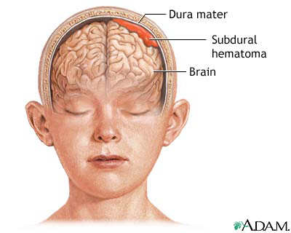

Slide 224
Death commonly results from
1) overwhelming neuronal injury after the initial bleeding;
2) rebleeding, which occurs in 4% of untreated patients in the first 24 hrs and 20% within 2 wks
3) profound cerebral ischemic damage from vasospasm.
The 30-day mortality rate is close to 50%, whereas the incidence of moderate to severe neurologic morbidity can reach 30%.

Slide 225
Pathophysiology of Cerebral Aneurysms
The most common cause of spontaneous SAH is rupture of a cerebral aneurysm.
Aneurysms are described as either saccular (berry-like) or fusiform, and the majority are less than 12 mm in diameter and classified as “small.”
Giant aneurysms (>24 mm in diameter) are found in less than 2% of all cases.

Slide 226
Degenerative changes in the cerebral arterial wall induced by turbulent blood flow at a vessel’s branching point contribute to the formation of aneurysms.
This susceptibility to hemodynamic stress may be related to structural abnormalities in these arteries.

Slide 227
Predisposing factors include a
Family history of the disease
Atherosclerosis
Hypertension
Coarctation of the aorta
Polycystic kidney disease
Fibromuscular dysplasia, and connective tissue disorders

Slide 228
The most common locations for aneurysms are
Anterior cerebral artery (40%),
Posterior communicating artery (25%)
Middle cerebral artery (25%).
vertebrobasilar system 10% mostly on the basilar artery.

Slide 229
The pathophysiologic changes that occur when an aneurysm ruptures include
A sudden large increase in ICP
A decrease in CPP
Spread of blood through the subarachnoid space causing inflammation and meningism

Slide 230
Cont…
Cerebral vasoconstriction
A decrease in cerebral blood flow (CBF), which may help stop further bleeding
Loss of cerebrovascular autoregulation

Slide 231
Diagnosis and Investigations
The clinical manifestations of SAH include
Sudden severe headache with vomiting
Neck pain (meningismus)
Photophobia
Seizures
Cranial nerve signs
Focal neurologic deficits
Transient loss of consciousness or prolonged coma.

Slide 232
Cont…
CT head scan will diagnose SAH in more than 95% of patients.
Digital subtraction angiography (DSA) is the “gold standard” investigation.
Recently, contrast-enhanced CT angiography

Slide 233
Treatment of Cerebral Aneurysms
Surgical or endovascular treatment of a patient within 2 to 3 days of a ruptured aneurysm minimizes the risk of rebleeding.
Grading systems help stratify the degree of impairment, complications, and guide prognosis.
A combination of the Hunt and Hess, World Federation of Neurological Surgeons, and the Fischer grading systems is used.

Slide 234
World Federation of Neurological Surgeon Grading Scale
WFNS Grade GCS Score Motor Deficit
I 15 Absent
II 14-13 Absent
III 14-13 Present
IV 12-7 Present or absent
V 6-3 Present or absent

Slide 235
Hunt and Hess Grading Scale
Grade 0 Unruptured aneurysm
Grade 1 Asymptomatic or minimal headache and
slight nuchal rigidity
Grade 2 Moderate to severe headache, nuchal rigidity,
no neurologic deficit other than cranial nerve palsy
Grade 3 Drowsiness, confusion, or mild focal deficit
Grade 4 Stupor, moderate to severe hemiparesis,
possible early decerebrate rigidity, vegetative
Grade 5 Deep coma, decerebrate rigidity, moribund
appearance

Slide 236
Serious systemic diseases, such as hypertension, diabetes, severe arteriosclerosis, chronic pulmonary disease, and severe vasospasm seen on arteriography, result in placement of the patient in the next less favorable category.

Slide 237
Patients who are Hunt and Hess grade I or II may undergo prompt treatment
patients with a GCS score less than 8 often have their intervention delayed until neurologic improvement occurs.

Slide 238
Surgical treatment of aneurysms involves craniotomy, microsurgical dissection, and the application of a clip across the aneurysm’s neck.
Some aneurysms may be able to be managed only by wrapping in muslin gauze, by trapping between clips, or by proximal occlusion of the common carotid artery.

Slide 239
Preoperative Evaluation
Many patients scheduled for intracranial aneurysm clipping come directly from the ICU, and elements of their management in the ICU may influence their immediate preoperative status.

Slide 240
Fluid Management
SIADH
cerebral salt-wasting syndrome, which probably occurs as a result of the release of a natriuretic peptide by the brain

Slide 241
management of both is simple: administration of isotonic fluids using intravascular normovolemia as the end point.

Slide 242
Vasospasm
Patients are at risk for vasospasm from approximately day 4 to day 16, with the peak incidence occurring on days 5 to 10 after SAH.
Subarachnoid blood and blood breakdown of hemoglobin products such as hemosiderin incite inflammation and leukocyte infiltration into adjacent blood vessels, which then become thickened and potentially spastic.

Slide 243
When there is a clinical suspicion of vasospasm, surgery is deferred, and angiography, or other imaging is performed.
Confirmed vasospasm is commonly treated with the “triple H” therapy and sometimes by balloon angioplasty or intra-arterial vasodilators.

Slide 244
In the ICU, the regimens employed to treat vasospasm usually involve some combination of hypervolemia, hemodilution, and hypertension.
Focal or global neurologic dysfunction can develop as a result of vasospasm-induced cerebral ischemia.
In patients in whom vasospasm develops, the risk of stroke or death is 20%.

Slide 245
Cont…
Phenylephrine and dopamine are the most commonly employed pressors
Most commonly, the objective is an increase in MAP of approximately 20 to 30 mm Hg above “baseline” systolic pressure.
Calcium Channel Blockers-Po -nimodipine
Iv -verapamil and nicardipine

Slide 246
Subarachnoid Hemorrhage–Associated Myocardial Dysfunction.
SAH can result in a reversible, “stunning”-like myocardial injury.
The mechanism is uncertain, but it is thought to be catecholamine mediated
Catecholamine-induced subendocardial
lesions typically occur in the vicinity of the cardiac nerves

Slide 247
Cont…
SAH may produce a functional cardiac denervation that is associated with release of troponin and regional wall motion abnormalities on echocardiography.
Diastolic dysfunction is also common and is associated with the severity of neurologic injury and may be the cause of pulmonary edema.

Slide 248
Pre operativelly
Patients need to be assessed for the presence and extent of all intracranial and extracranial complications of SAH.

Slide 249
Intracranial complications include
Rebleeding
Vasospasm leading to cerebral ischemia/infarction
Hydrocephalus
Expanding intracerebral hematoma
Seizures

Slide 250
Extracranial complications include
1) myocardial ischemia/infarction,
(2) cardiac dysrhythmias
(3) neurogenic pulmonary edema, and
(4) gastric hemorrhage.

Slide 251
Anesthetic Technique
The important considerations in anesthetic technique include the following:
1. Absolute avoidance of acute hypertension with its attendant risk of rerupture
2. Provision of intraoperative brain relaxation to facilitate surgical access to the aneurysm

Slide 252
Cont…
3. Maintenance of a high-normal
MAP(CPP)
4. Preparedness to perform precise manipulations of MAP

Slide 253
Monitoring
An arterial line is invariably appropriate. CVP may be relevant for large doses of mannitol to promote brain relaxation and may be used in older patients to guide volume replacement in the event of bleeding.

Slide 254
Anesthetic Selection.
Any technique that permits proper control of MAP is acceptable.
In the face of increased ICP or a tight surgical field, an inhaled agent technique may be less suitable.
The prevention of paroxysmal hypertension

Slide 255
Induced Hypotension
sodium nitroprusside infusion
Induced Hypertension.
may be requested during periods of temporary arterial occlusion to augment collateral CBF. transient elevation of the systolic pressure to 150 mm Hg. Phenylephrine is suitable

Slide 256
Cont…
Hypocapnia.
Lumbar Cerebrospinal Fluid Drainage
Mannitol

Slide 257
Emergence
patients should be extubated with a minimum of coughing or blood pressure fluctuation.
Blood pressure control is important for patients with unruptured aneurysms.

Slide 258
Postoperative Anesthetic Care
May need ICU to ensure
Continued hemodynamic monitoring,
Adequate oxygenation
Optimum fluid and electrolyte management
Early detection of complications such as vasospasm.
Analgesics

Slide 259
Arteriovenous Malformations
An AVM is an abnormal collection of dysplastic vessels. 75% are supratentorial.
AVMs are congenital lesions and are usually manifested before the age of 40 as cerebral hemorrhage (most common)

Slide 260
Cont…
A problem that is specific to AVMs is the phenomenon known as “perfusion pressure breakthrough,” or cerebral dysautoregulation.
It is characterized by an often sudden engorgement and swelling of the brain, sometimes with a relentless cauliflower-like protrusion from the cranium.

Slide 261
Anesthetic Technique
The management constraints are essentially the same as those relevant to aneurysm surgery, although the risk of intraoperative rupture is much less.
severe intraoperative bleeding can occur and may be associated with malignant cerebral edema.

Slide 262
cont…
With severe episodes of swelling, we have employed hypocapnia, hypothermia, and barbiturates
prevent pop hypertension in AVM surgery,
Edema or hemorrhage if hypertension occurs

